Slide 1
EMPTY STRING or NULL STRING
Sometimes a string with no symbol at all is used, denoted by (Small Greek letter Lambda) λ or (Capital Greek letter Lambda) Λ, is called an empty string or null string.
The capital lambda will mostly be used to denote the empty string, in further discussion.

Slide 2
Length of Strings
Definition:
The length of string s, denoted by |s|, is the number of letters in the string.
Example:
Σ={a,b}
s=ababa
|s|=5

Slide 3
Example:
Σ= {B, aB, bab, d}
s=BaBbabBd
Tokenizing=(B), (aB), (bab), (B), (d) |s|=5

Slide 4
Reverse of a String
Definition:
The reverse of a string s denoted by Rev(s) or s^{r}, is obtained by writing the letters of s in reverse order.
Example:
If s = abc is a string defined over
Σ={a,b,c} then
Rev(s) or s^{r} = cba

Slide 5
Reverse of a String
Example:
Σ= {B, aB, bab, d}
s=BaBbabBd
Tokenizing=(B) (aB) (bab) (B) (d)
Rev(s)=dBbabaBB

Slide 6
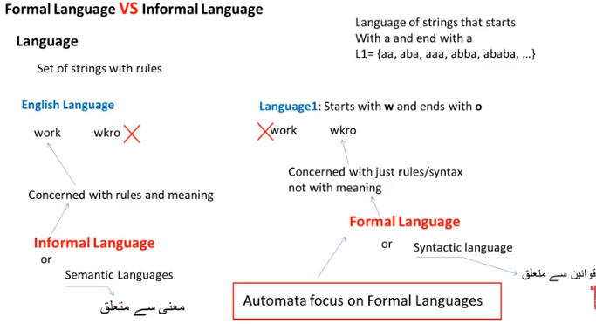

Slide 7
Defining Languages
The languages can be defined in different ways , such as
Descriptive definition,
Recursive definition,
using Regular Expressions(RE) and
using Finite Automaton(FA) etc.
Descriptive definition of language:
The language is defined, describing the conditions imposed on its words.

Slide 8
Example:
The language L of strings of odd length, defined over Σ={a}, can be written as
L={a, aaa, aaaaa,…..}
Example:
The language L of strings that does not start with a, defined over Σ={a,b,c}, can be written as
L={b, c, ba, bb, bc, ca, cb, cc, …}

Slide 9
Example:
The language L of strings of length 2, defined over Σ={0,1,2}, can be written as
L={00, 01, 02,10, 11,12,20,21,22}
Example:
The language L of strings ending in 0, defined over Σ ={0,1}, can be written as L={0,00,10,000,010,100,110,…}

Slide 10
Example:
The language EQUAL, of strings with number of a’s equal to number of b’s, defined over Σ={a,b}, can be written as
{Λ ,ab,aabb,abab,baba,abba,…}
Example:
The language EVEN-EVEN, of strings with even number of a’s and even number of b’s, defined over Σ={a,b}, can be written as
{Λ, aa, bb, aaaa,aabb,abab, abba, baab, baba, bbaa, bbbb,…}

Slide 11
Example:
The language factorial, of strings defined over Σ={1,2,3,4,5,6,7,8,9} i.e. {1,2,6,24,120,…}
Example:
The language FACTORIAL, of strings defined over Σ={a}, as {a^{n!} : n=1,2,3,…}, can be written as {a,aa,aaaaaa,…}.
It is to be noted that the language FACTORIAL can be defined over any single letter alphabet.

Slide 12
An Important language
PALINDROME
The language consisting of Λ and the strings s defined over Σ such that Rev(s)=s. It is to be denoted that the words of PALINDROME are called palindromes.
Example:
For Σ={a,b}, PALINDROME={Λ , a, b, aa, bb, aaa, aba, bab, bbb, ...}

Slide 13
TASK FILE
1.The language DOUBLEFACTORIAL, of strings defined over Σ={a, b}, as {a^{n!} b^{n!} : n=1,2,3,…}, can be written as
2. The language SQUARE, of strings defined over Σ={a}, as
{a^{n2} : n=1,2,3,…}, can be written as
3. The language {a^{n}b^{n}}, of strings defined over Σ={a,b}, as {a^{n}b^{n} : n=1,2,3,…}, can be written as
4. The language {a^{n}b^{n} a^{n}}, of strings defined over Σ={a,b}, as {a^{n}b^{n} a^{n} : n=1,2,3,…}, can be written as
5. The language INTEGER, of strings defined over Σ={-,0,1,2,3,4,5,6,7,8,9}, can be written as
6. The language EVEN, of stings defined over
Σ={-,0,1,2,3,4,5,6,7,8,9}, can be written as

Slide 14
Kleene Star/Kleene Closure/Kleene Operator
Given Σ, then the Kleene Star Closure of the alphabet Σ, denoted by Σ*, is the collection of all strings defined over Σ, including Λ.
It is to be noted that Kleene Star Closure can be defined over any set of strings.

Slide 15
Examples
If Σ = {x}
Then Σ* = {Λ, x, xx, xxx, xxxx, ….}
If Σ = {0,1}
Then Σ* = {Λ, 0, 1, 00, 01, 10, 11, ….}
If Σ = {aaB, c}
Then Σ* = {Λ, aaB, c, aaBaaB, aaBc, caaB, cc, ….}

Slide 16
Note
Languages generated by Kleene Star Closure of set of strings, are infinite languages.
(By infinite language, it is supposed that the language contains infinite many words, each of finite length).

Slide 17
Kleene PLUS/Kleene Positive/Positive Closure
Plus Operation is same as Kleene Star Closure except that it does not generate Λ (null string), automatically.
Example:
If Σ = {0,1}
Then Σ+ = {0, 1, 00, 01, 10, 11, ….}
If Σ = {aab, c}
Then Σ+ = {aab, c, aabaab, aabc, caab, cc, ….}

Slide 18
TASK
Q1)Is there any case when S⁺ contains Λ? If yes then justify your answer.

Slide 19
Remark
It is to be noted that Kleene Star can also be operated on any string i.e. a* can be considered to be all possible strings defined over {a}, which shows that a* generates Λ, a, aa, aaa, …
It may also be noted that a+ can be considered to be all possible non empty strings defined over {a}, which shows that a+ generates
a, aa, aaa, aaaa, …

Slide 20
Defining Languages Continued…
Recursive definition of languages:
The following three steps are used in recursive definition
Some basic words are specified in the language.
Rules for constructing more words are defined in the language.
No strings except those constructed in above, are allowed to be in the language.

